Slide 1
Android SIG November Meeting
November 15, 2022

Slide 2
Antitrust Policy Notice
RISC-V International meetings involve participation by industry competitors, and it is the intention of RISC-V International to conduct all its activities in accordance with applicable antitrust and competition laws. It is therefore extremely important that attendees adhere to meeting agendas, and be aware of, and not participate in, any activities that are prohibited under applicable US state, federal or foreign antitrust and competition laws.
Examples of types of actions that are prohibited at RISC-V International meetings and in connection with RISC-V International activities are described in the RISC-V International Regulations Article 7 available here: https://riscv.org/regulations/
If you have questions about these matters, please contact your company counsel.

Slide 3
RISC-V International
RISC-V is a free and open ISA enabling a new era of processor innovation through open standard collaboration. Born in academia and research, RISC-V ISA delivers a new level of free, extensible software and hardware freedom on architecture, paving the way for the next 50 years of computing design and innovation.
We are a transparent, collaborative community where all are welcomed, and all members are encouraged to participate.
We as members, contributors, and leaders pledge to make participation in our community a harassment-free experience for everyone.
https://riscv.org/risc-v-international-community-code-of-conduct/

Slide 4
Agenda
Current Status and Update
Gap Analysis
Develop riscv64 support on AOSP master
Open Discussion

Slide 5


Current Status and Update
Upstream enablement has started(Oct 01)
First batch of patch for RISC-V target
Collaborate with the AOSP team(Google)
Two new blogs were posted(Oct 23)
Porting background
Previous News/blogs
https://riscv.org/news/risc-v-blog/

Slide 6
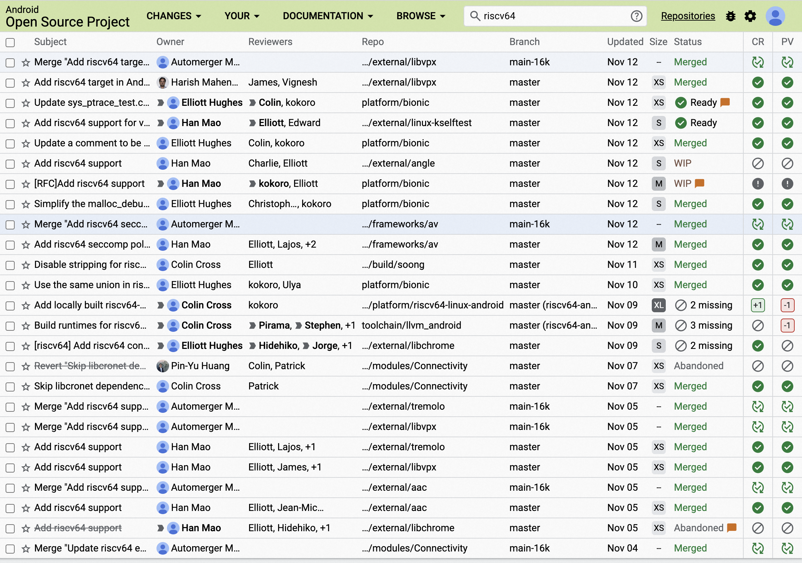
Current Status and Update
200+ Changes are created
170+ Changes are merged
Target: aosp_riscv64
Support added: build, bionic, LLVM/Clang, system, framework, XTS and 3-rd party libraries
TODO: under Gap Analysis
https://android-review.googlesource.com/q/riscv64

Slide 7
Current Status and Update
Next meeting
Dec 20？
Regular meeting
Monthly（Every 2-nd Tuesday?）
May change the frequency on demand
Issues tracker
https://github.com/riscv-android-src/riscv-android/issues
https://docs.google.com/spreadsheets/d/1HifwLJCBeLxgtXo-D1O1POlsBlybRokCmAj3yljq9NM/edit#gid=0 (Gap Analysis & Overview)
https://bugs.chromium.org/p/gerrit/issues/list (Common issues?)

Slide 8
Gap Analysis
https://docs.google.com/spreadsheets/d/1HifwLJCBeLxgtXo-D1O1POlsBlybRokCmAj3yljq9NM/edit#gid=0
Some missing items should be added.
Need to add more detail and comparison.
Need to update priority and assignments
Everyone can edit it

Slide 9
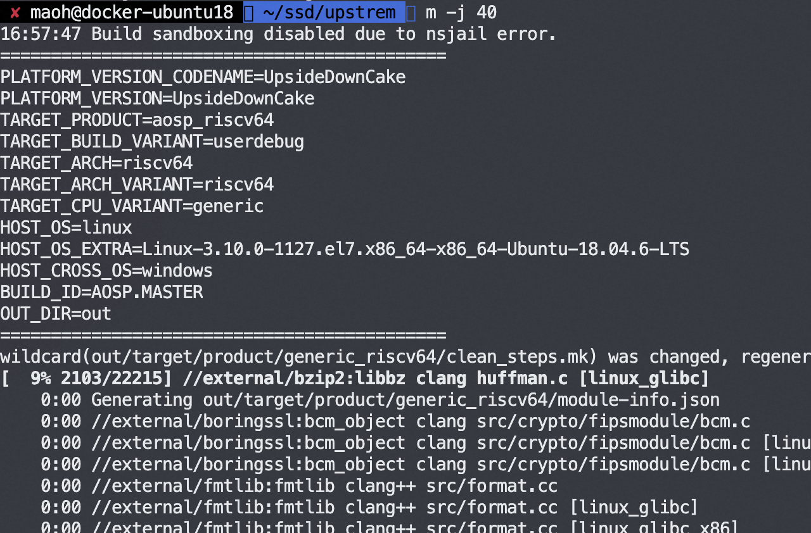
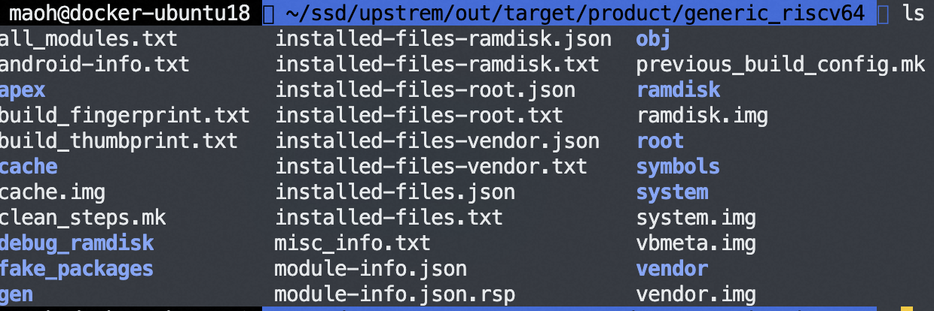
Develop riscv64 support on AOSP master
> mkdir android-src
> cd android-src
> repo init -u https://android.googlesource.com/platform/manifest
# Use mirror when googlesource is not accessible
#repo init -u https://mirrors.tuna.tsinghua.edu.cn/git/AOSP/platform/manifest
> repo sync
> source build/envsetup.sh
> lunch aosp_riscv64-userdebug
> m -j
Setup build environment

Slide 10
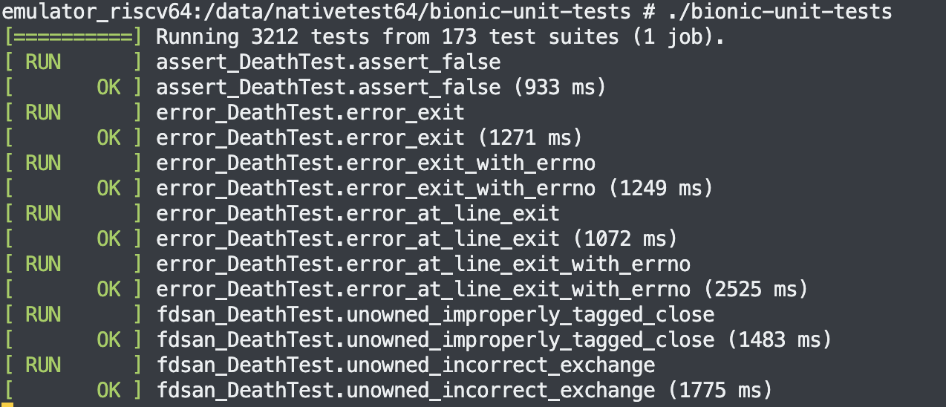
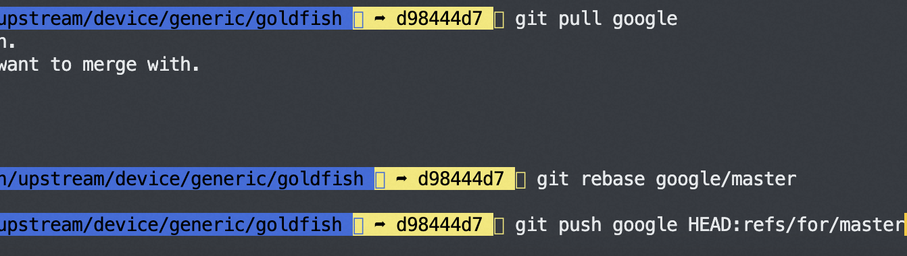
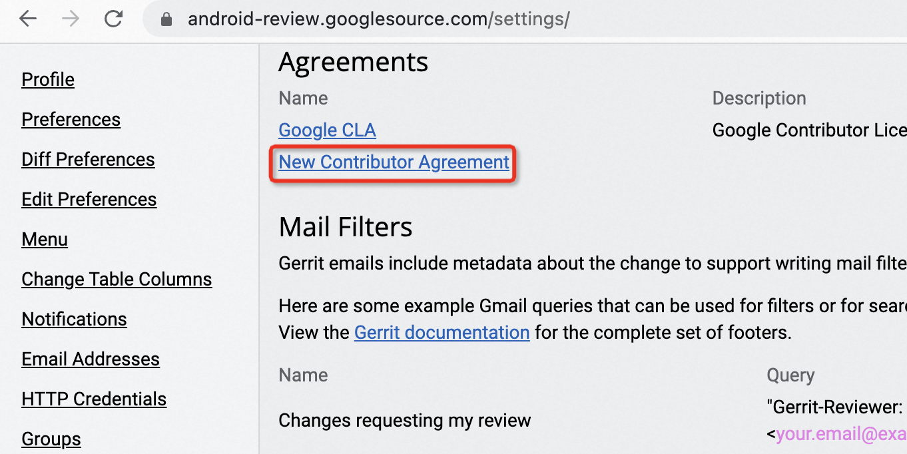
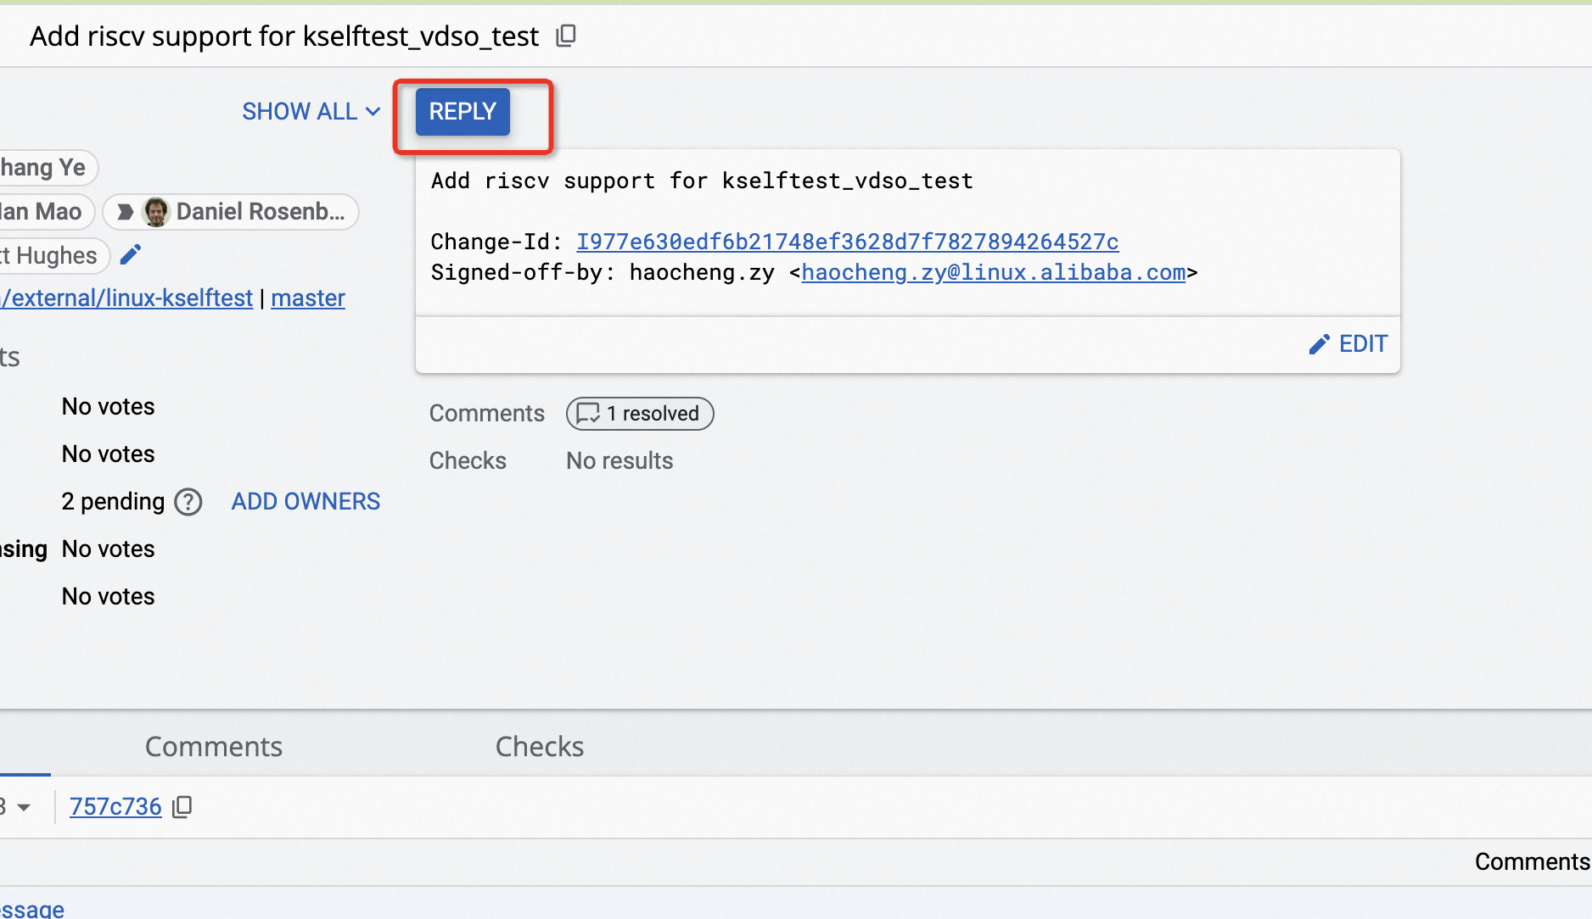
Develop riscv64 support on AOSP master
Test on qemu/emulator
Upload patch for review
（Should not include any prebuilts）
Sign CLA agreement
Assign reviewer(@enh)
https://source.android.com/docs/setup/contribute/submit-patches

Slide 11
Open Discussion
…

Slide 12
Thank You

